Slide 1

Advanced Topics in Economic Evaluation and Healthcare
Lecture #11:Multiple Criteria Decision Analysis

Slide 2
Lecture Overview
In this lecture we will provide an introduction to multiple criteria decision analysis. In particular we will discuss:
  What multiple criteria decision analysis is.
  How multiple criteria decision analysis is conducted.
  An Example of MCDA from published literature.
  Some “Economic” Critiques of MCDA
By the end of this lecture you will have a conceptual overview of what multiple criteria decision analysis is and how it is conducted.

Slide 3
An Introduction to Multiple Criteria Decision Analysis

Slide 4
What is multiple criteria decision analysis
Multi-Criteria Decision Analysis (MCDA) is a structured evaluation framework used to compare, rank, and choose between options when facing multiple conflicting objectives.
It is a tool used when choices involve multiple outcome measures or multiple attributes which may or may not depend on each other.
This is different from what we have been working on for this entire course which can be more broadly thought of as a single criteria decision analysis (the single criteria being the ICER).
To move decision analysis to environments which are made complex by the number of items considered we need a slightly different set of tools.

Slide 5
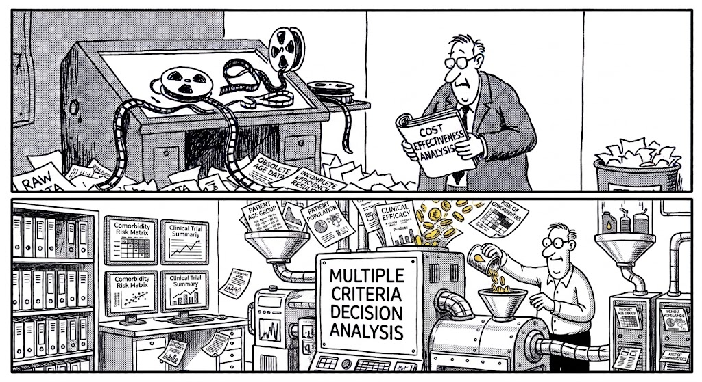
On the Need for Multi Criteria Decision Analysis in Health Technology Assessment
Fact: Clinical trials report multiple different outcomes.
Health Economists and analysts who use clinical trials as a primary source of information for cost effectiveness analysis are forced to choose specific results:
  VSL analysis requires us to use mortality rates alone.
  Additional risks of comorbidities are used in a model specific format.
  For CEA, scale-specific outcomes are used on their own.
  For CUA we may convert effects into QALYs using the EQ-5D-5L.
NOTE: That when we do health technology assessment in the way we have been discussing, we necessarily leave material on the cutting room floor.

Slide 6



The “Fathers” of Multiple Criteria Decision Analysis
Ralph L. Keeny
Howard Raffia

Slide 7
What a multiple criteria decision analysis is and is not.
A multiple criteria decision analysis is not an alternative to cost effectiveness analysis.
Its an alternative to the LEAGUE TABLE approach for making funding decisions over multiple projects.
  The league table will rank treatments according to their ICERs.
  A Multiple Criteria Decision Analysis will rank treatments according to a score.
MCDA is useful when decision makers are explicit about how economics and cost-effectiveness are only a single criteria when they are making decisions.
It is also useful when we wish to rank based on multiple ICERs with different denominators. (i.e. for Benefit-Risk Reduction Analysis).

Slide 8
Single Criteria Decision Analysis VS Multiple Criteria Decision Analysis
Single Criteria (ICER ONLY)
Multiple Criteria
Treatment | ICER
Cardiovascular Prevention | $12,000/QALY
Digital Mental Health Program | $25,000/QALY
Oncology Immunotherapy | $48,000/QALY
Orphan Drug | $120,000/QALY
Treatment | ICER | Patient Population | Clinical Efficacy | Age Group
Cardiovascular Prevention | $12,000/QALY | Large | Moderate | 50+
Digital Mental Health Program | $25,000/QALY | Moderate | Low | 15-35
Oncology Immunotherapy | $48,000/QALY | Moderate | Moderate | 40-65
Orphan Drug | $120,000/QALY | Small | High | 0-5

Slide 9
Single Criteria Decision Analysis VS Multiple Criteria Decision Analysis
Single Criteria (ICER ONLY)
Multiple Criteria
Treatment | ICER
Cardiovascular Prevention | $12,000/QALY
Digital Mental Health Program | $25,000/QALY
Oncology Immunotherapy | $48,000/QALY
Orphan Drug | $120,000/QALY
Treatment | ICER | Patient Population | Clinical Efficacy | Age Group
Cardiovascular Prevention | $12,000/QALY | Large | Moderate | 50+
Digital Mental Health Program | $25,000/QALY | Moderate | Low | 15-35
Oncology Immunotherapy | $48,000/QALY | Moderate | Moderate | 40-65
Orphan Drug | $120,000/QALY | Small | High | 0-5
Under Multiple Criteria Decision Analysis
we need a Method for Scoring Each of these
Attributes. (We will use more data than needed)

Slide 10
How to do a Multiple Criteria Decision Analysis

Slide 11
How to do a multiple criteria decision analysis.
Knowing that for MCDA we will be using more data than just the ICER for funding prioritization we need a guide for how to conduct it.
Multiple Criteria Decision Analysis Involves three steps.
Step 1: Choose your Data.
Step 2: Numerate all non-numeric attributes.
Step 3: Generate a score under a scoring function.

Slide 12

Choosing Data for a MDCA
When we choose data for MCDA, we care about if this is something that is important to decision makers.
Theres no limit on the number of attributes or goals a problem can have.
All we need to ask in the context of a MCDA.
The UN has 17 sustainable development goals.
Under MCDA, we cannot say if this is good or bad based on the number of objectives.
What is needed is that the data can be RANKED.

Slide 13
Numerating Each Attribute
After selecting data we need to numerate it.
There are very few restrictions on the scoring of data, however the scale should be reflective of the number of levels in the data.
In general larger numbers should correspond to better outcomes (i.e. high, moderate, low should be numerated by 3, 2 and 1 etc.)
This converts each “attribute” into a score.
Scoring must be applied to every attribute in a data table.
An Example of “Scoring”
Treatment | Clinical Efficacy | Clinical Efficacy Score
Cardiovascular Prevention | Moderate | 2
Digital Mental Health Program | Low | 1
Oncology Immunotherapy | Moderate | 2
Orphan Drug | High | 3

Slide 14
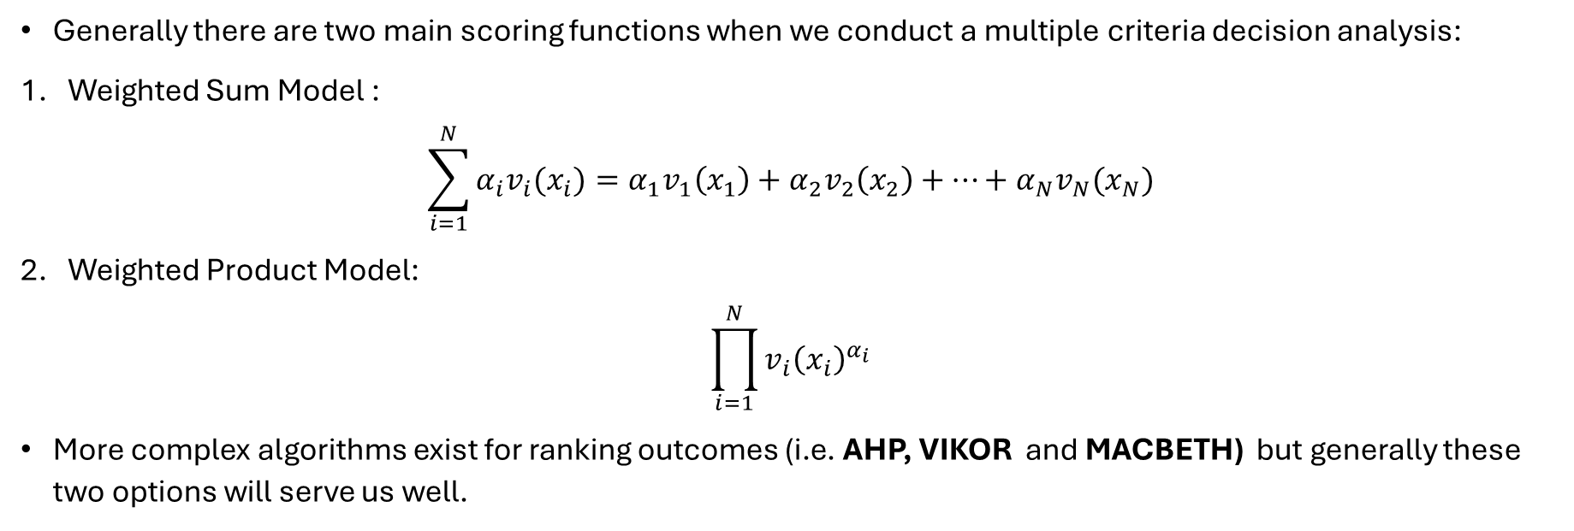
Scoring Functions
Generally there are two main scoring functions when we conduct a multiple criteria decision analysis:
Weighted Sum Model :
$\sum_{i=1}^{N}{α_{i}v_{i}(x_{i})}=α_{1}v_{1}\left(x_{1}\right)+α_{2}v_{2}\left(x_{2}\right)+…+α_{N}v_{N}(x_{N})$
Weighted Product Model:
$\prod_{i=1}^{N}{v_{i}{\left(x_{i}\right)}^{α_{i}}}$
More complex algorithms exist for ranking outcomes (i.e. AHP, VIKOR and MACBETH) but generally these two options will serve us well.

Slide 15
MCDA in the literature
Matera, Maria Gabriella, et al. "Multi-criteria decision analysis of biologics in chronic obstructive pulmonary disease." International Journal of Chronic Obstructive Pulmonary Disease (2025): 3163-3173.

Slide 16

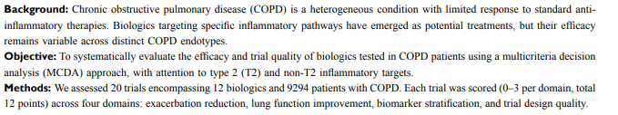

Slide 17
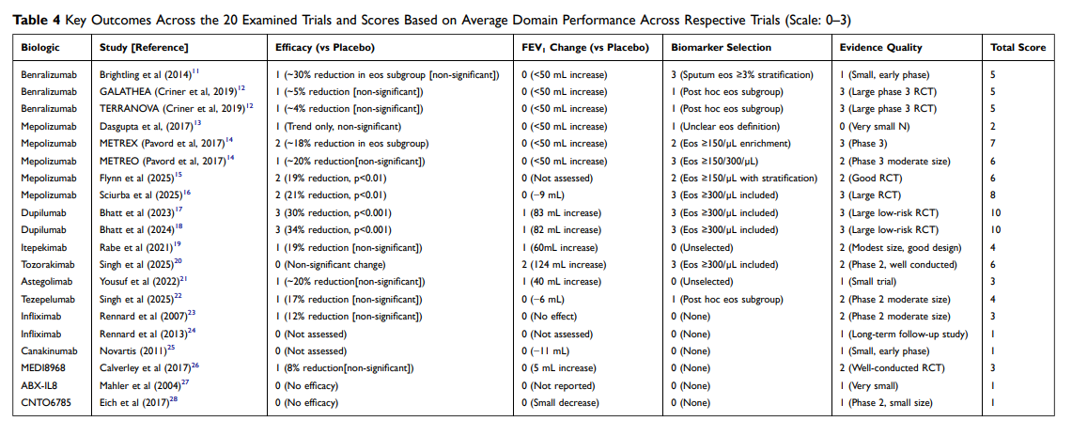

Slide 18
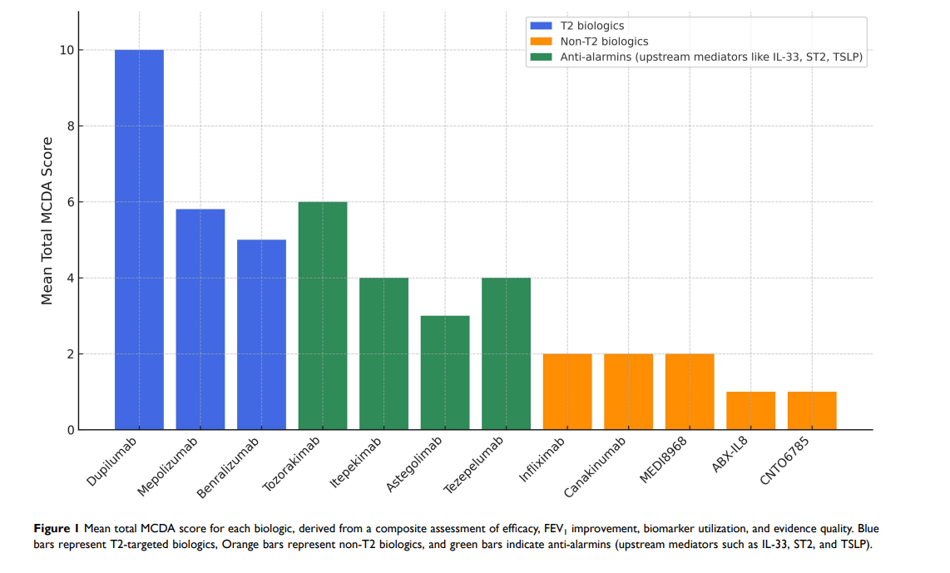

Slide 19
MCDA is a
Great tool
for forming
rankings over
treatments!

Slide 20
Some Economic Critiques of MCDA

Slide 21

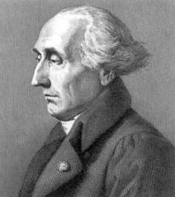
Critique #1:Tinbergen Rule
N problems require N policy instruments.
This follows immediately from LaGrange’s work on optimization.
Misdiagnosing multiple problems (social, environmental, economic) for a single one will thus get the solution wrong.
Jan Tinbergen
1903-1994
Joseph-Louis Lagrange
1736-1813

Slide 22
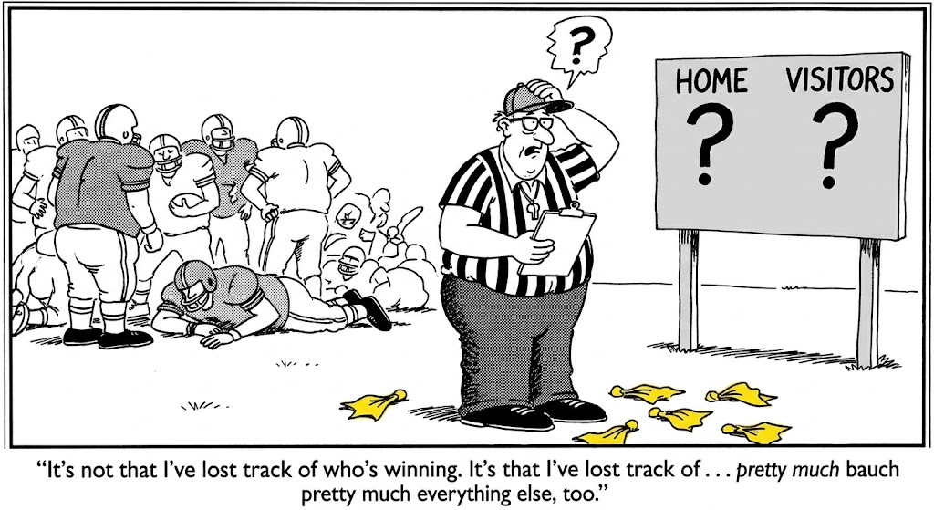
Critique #2: Who determines the score
Multiple criteria decision analysis provides very little guidance on how attributes should be weighted.
Even after careful reasoning, we may not truly pin down the correct way to weight each outcome.
Changing of weights can radically impact the ranking of results.
Sensitivity analysis of weights is very important for this reason.

Slide 23
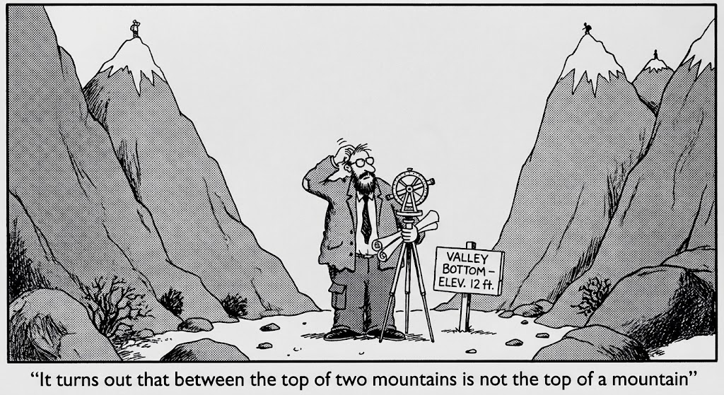
Critique #3: Cost Effectiveness is a more reliable tool
We all care about generating value for money.
By choosing to maximize over a score we are choosing some best choice over a weighted average of possible best choices.
Maximizing over multiple objectives can lead us to situations where none of these objectives are satisfied.
Ranking under the ICER is more reliable, because we are sure pick the best choice under a single criteria.
Under multiple criteria we may get nowhere.

Slide 24
Concluding Remarks
Multiple Criteria Decision Analysis is a powerful tool for ranking alternatives beyond the use of league tables.
They can accommodate many attributes and can be employed simply using some very basic algorithms.
They can inform best clinical practices with new drugs and provide guidance on funding decisions beyond cost effectiveness.
They are not without their own limitations as MCDA is very sensitive to scoring methods and weighting of attributes.

